Slide 1

O&M Assessment Tools - Children
Community of Practice Meeting - 19/08/25
Presented by Angela Reynolds (ROMSA)
Notes:
This is a very brief overview of some Orientation & Mobility assessment tools available that are currently being used by O&M’s in Australia. It is by no means a full and extensive list. There are many more.

Slide 2

O&M Inventory – New Mexico School the Blind and Vision Impaired (NMSBVI)
Birth to 6 years old
6 years and up
Multiple Disabilities
Wheelchair
O&M Assessment Tools – Angela Reynolds
Notes:
4 different inventories to address varied ages & abilities.

Slide 3
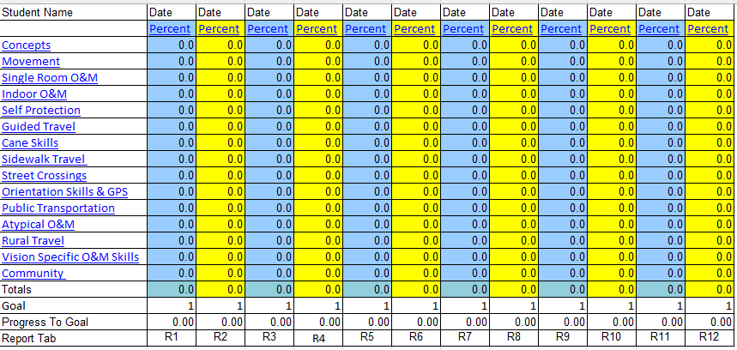
Front page of the 6 yrs and up O&M Inventory – domains covered
O&M Assessment Tools – Angela Reynolds
Notes:
% scores are calculated to give an indication of the attainment of a skill or domain that the client has mastered. 100% indicates that the client has the full skill set to travel as an adult. 70% indicates they have 70% of the skills required to travel as an adult and then you can identify training goals from there that work towards developing increased skills.
The % scores are an excellent way to demonstrate measurement of current skill level and the need for further O&M services.

Slide 4
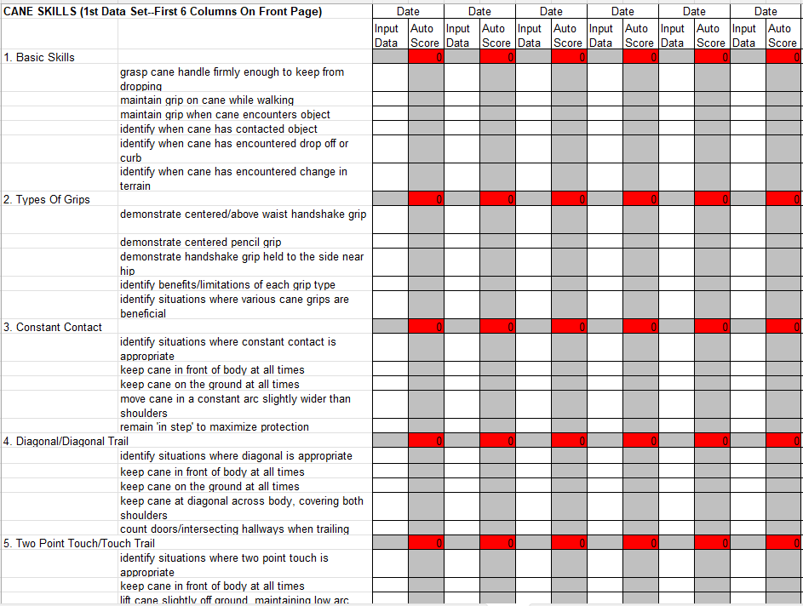
Example of cane skills covered in NMSBVI 6 yrs & up
O&M Assessment Tools – Angela Reynolds

Slide 5
https://nmsbvi.org/235010_2
Free to download from website
O&M Assessments Tools – Angela Reynolds
Notes:
Everything you need is here,
Excel spreadsheet assessment documents
Word checklists that provide an overview of skills
Video tutorials to help you learn how

Slide 6
Teaching Age-Appropriate Purposeful Skills – TAPS
O&M Assessments Tools – Angela Reynolds

Slide 7
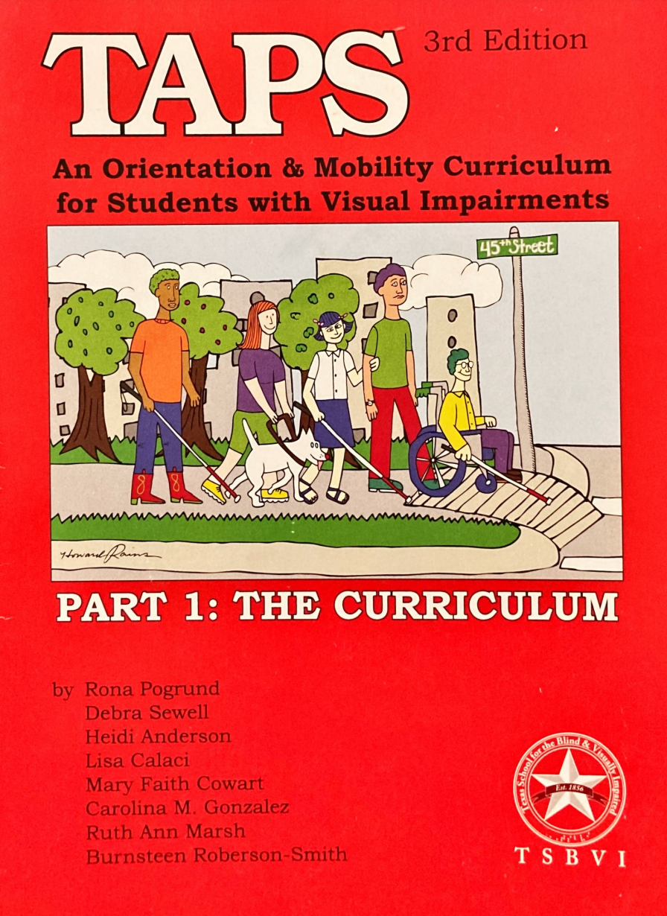
Part 1 – The Curriculum
Everything we need to know about O&M (nearly) is there, 370 pages.
Assessment and Training
Concepts
Skills – protective techniques, human guide and canes
Home
School
Residential
Commercial
Public Transport
Notes:
Produced by TSBVI in the US.
4 Parts.
Part 1 – Curriculum – all the skills and how to teach them.
Part 2 – Is the Evaluation form. Matches up with the curriculum for easy reference between the 2.
Sometimes the terminology may be a bit different as it’s written in the US.
The curriculum & evaluation booklets are divided into O&M goals/skills/subskills.
Excellent resources that can be shared with families and other professionals to help everyone work in a transdisciplinary model of support for children.

Slide 8
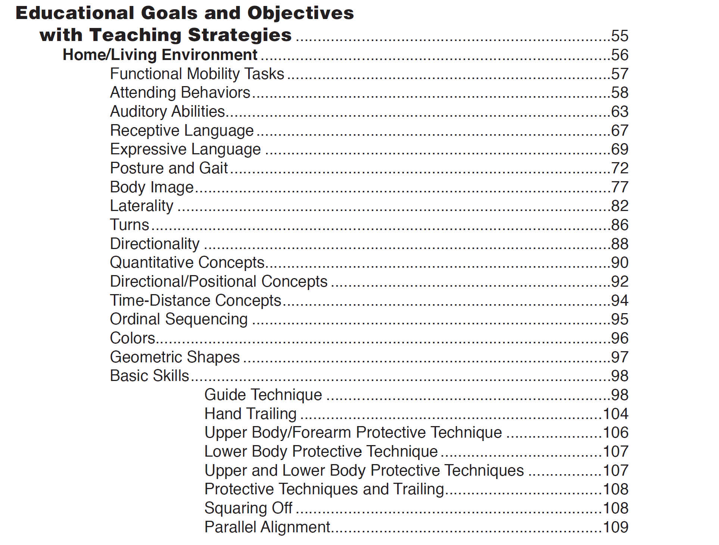
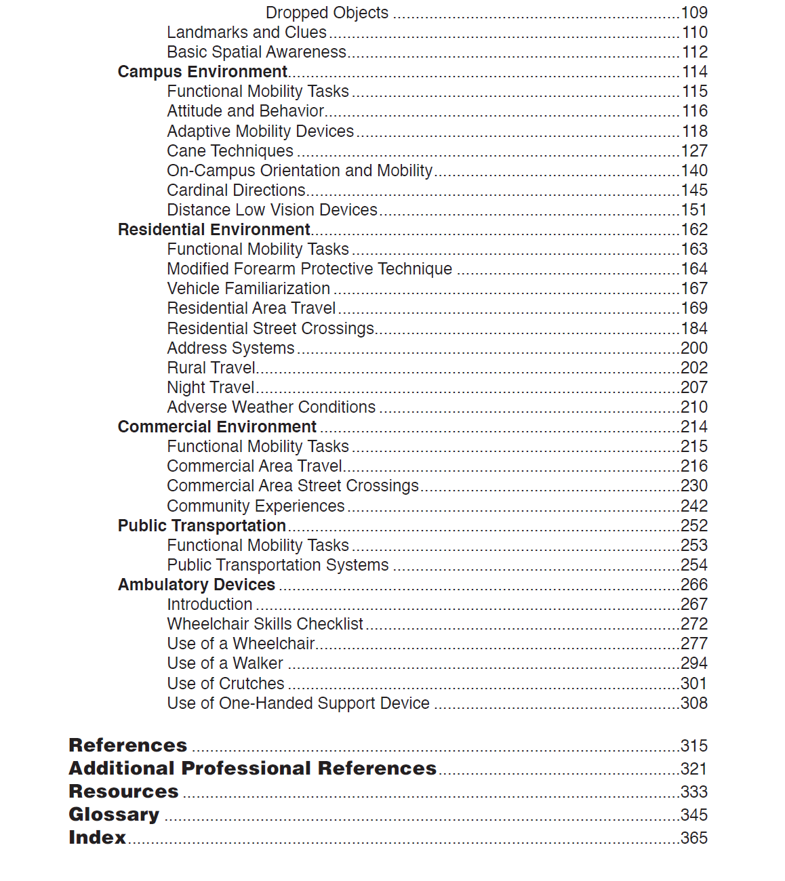
TAPS
Notes:
I have to admit I was a little overwhelmed getting my head around everything in this resource. There’s a lot here!
Designed to be used at schools in Texas as an O&M evaluation and curriculum tool – nearly all the O&M skills a well rounded student might need for the rest of their lives. We can see headings such as home/living, campus, residential. Try not to get bogged down by these headings and look at the skills listed underneath.
Home – guiding skills, self protective skills.
Campus – cane skills located but we know cane skills used in many different locations.
Try to focus on what skills are relevant for the client, their goals and the skills that are required to meet these goals.

Slide 9
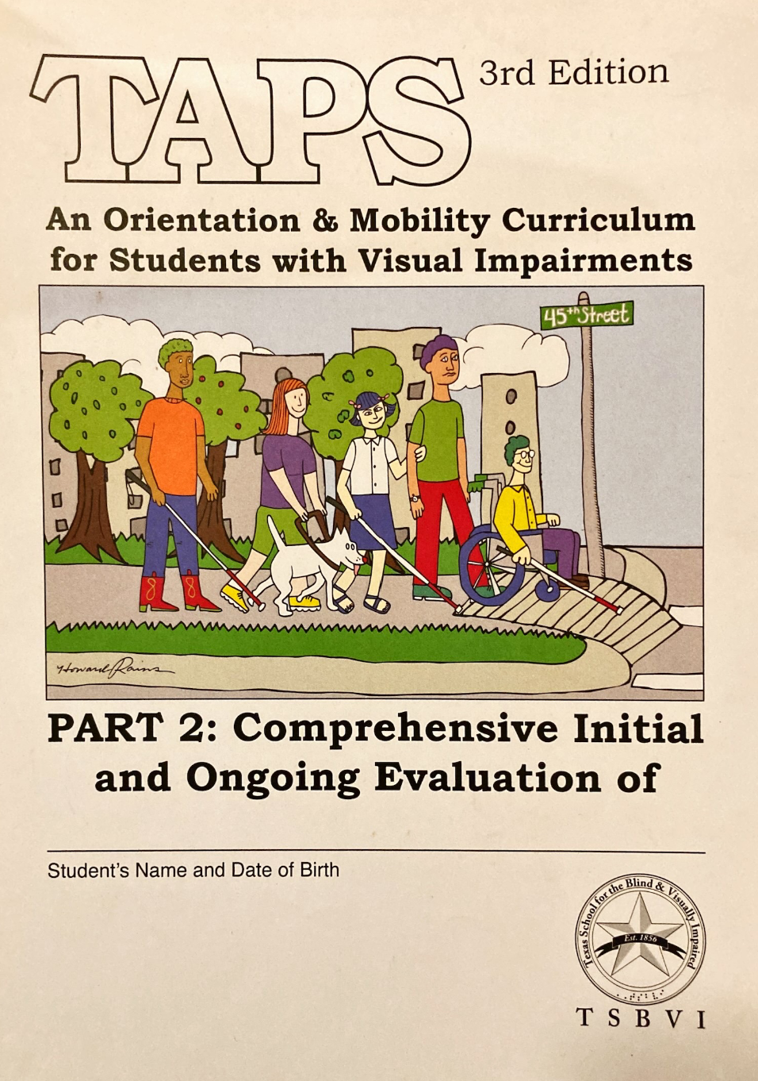
Part 2 – Evaluation/Assessment
Skills listed, record information, 118 pages.
Same categories as Part 1.
Assessment and Training
Concepts
Skills – protective techniques, human guide and canes
Home
School
Residential
Semi- business and CBD
Public Transport
Notes:
These 2 books are aligned to work together. If you look you can see that the contents page in both the books is exactly the same. The same functional mobility goals, skills and subskills are listed. In part 2 it’s simply a list. Then in part 1 – the curriculum there are teaching strategies listed for each skill.
Scoring,
Score the tasks by using one of the following codes:
E = Emerging – the student can do the task only within a familiar routine when there is no novelty introduced or needs a considerable amount of prompting to perform.
C = Competence – the student performs the task consistently in at least one setting or inconsistently but well in several settings.
G = Generalized – the student performs the task well in many settings over a period of time.
TAPS provides lists of sequential skills and subskills. Links directly with curriculum about how to teach all skills.

Slide 10
Part 3 - Appendices
Part 4 – Road Crossings (USA – right sided driving)
O&M Assessments Tools – Angela Reynolds
Notes:
Both are excellent resources.
Even though it’s right sided driving you can adjust the documents to make them more user friendly. Substituting right for left in the word documents. They provide excellent scaffolding to use in your O&M practice to teach clients about road crossings.

Slide 11
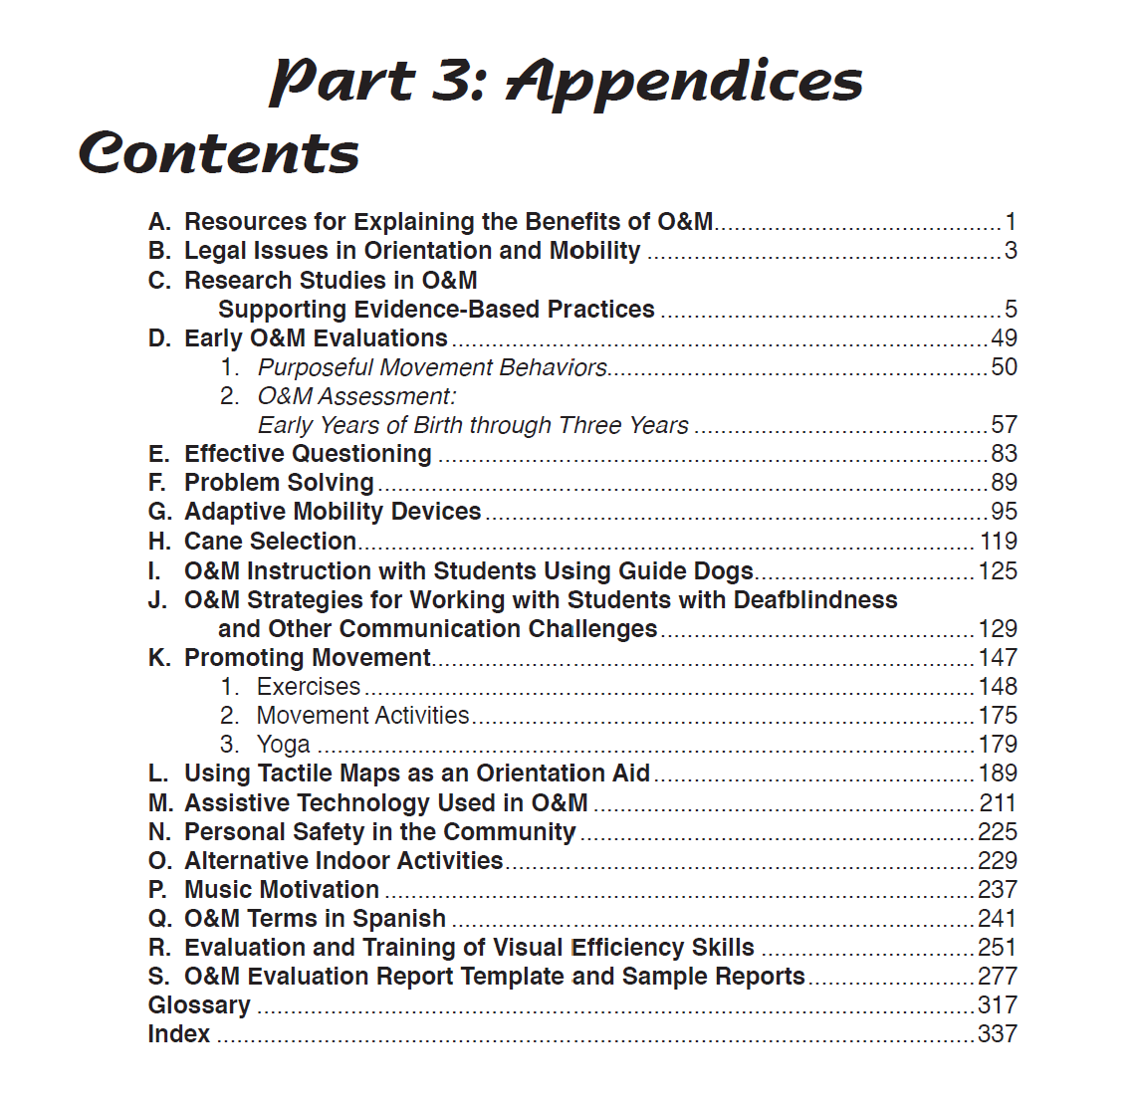

TAPS
Notes:
The additional Part 3 and Part 4 are appendices of additional information and more detail about road crossings. There is lots of information in them. Look over them at some stage to get an idea about what they contain and the level of detail. As you work through training programs you may like to delve deeper into some of the resources in part 3 and 4 when they are relevant.

Slide 12
Purchase from Texas School for the Blind & Vision Impaired (TSBVI)
https://www.tsbvi.edu/product/taps-teaching-age-appropriate-purposeful-skills-an-orientation-mobility-curriculum-for-students-with-visual-impairments-3rd-edition
$117 USD + postage
Hardcopy or digital copy
O&M Assessments Tools – Angela Reynolds
Notes:
For anyone at GDN & GDV have their own copies digital.

Slide 13
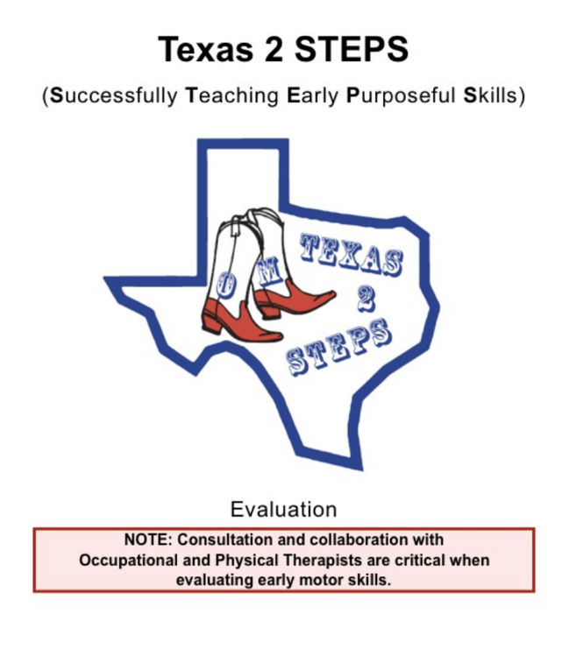
O&M Assessments Tools – Angela Reynolds
Notes:
Released 2018
Designed to determine and address the mobility needs of children between birth & 5 years.

Slide 14
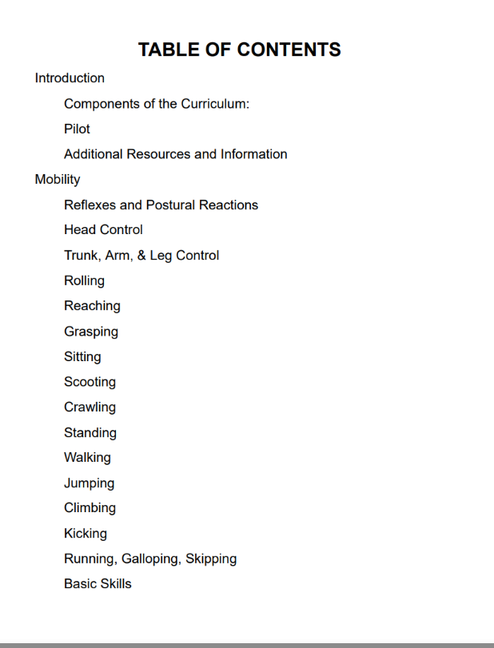
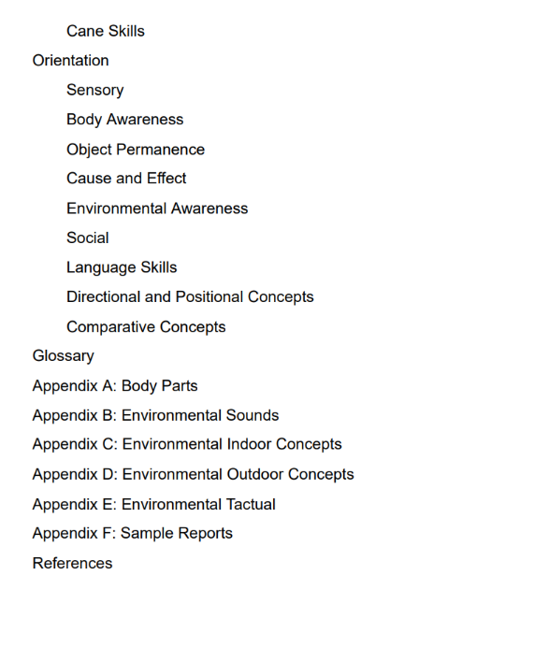
O&M Assessments Tools – Angela Reynolds
Notes:
It’s divided into 2 domains – Orientation & Mobility
Each domain is subdivided into 16 Mobility areas and 9 Orientation areas.
There is an evaluation booklet to use at the initial stage of assessment and for re-assessments.

Slide 15
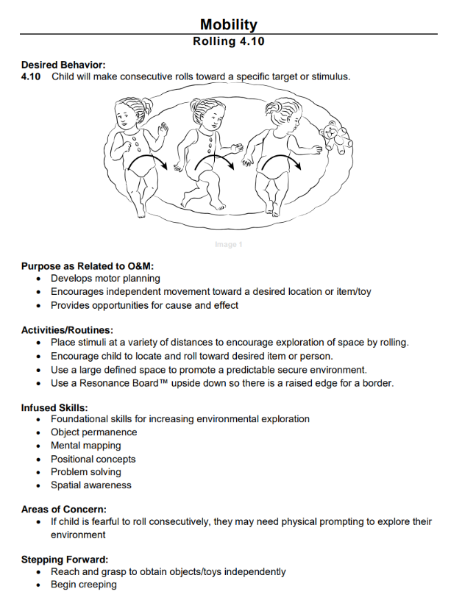
Example of how the progression of a child learning rolling skills.
O&M Assessments Tools – Angela Reynolds
Notes:
And a Curriculum booklet that provides detailed and sequential information about each specific O&M goal or desired behaviour, the purpose of the skill, how it relates to O&M, suggested activities and how to embed them into routines, troubleshooting ideas and possible next goals to work on that are developmentally appropriate.
This resource acknowledges & recommends the importance of working closely with Occupational Therapists and Physiotherapists when supporting a child & their family to work on these skills.

Slide 16
Purchase from Texas School for the Blind & Vision Impaired (TSBVI)
https://www.tsbvi.edu/product/texas-2-steps-curriculum-and-evaluation-set
$182 USD + postage
Hardcopy or digital version
O&M Assessments Tools – Angela Reynolds
Notes:
For any O&M’s here there are digital copies of both the TAPS and Texas 2 Steps available at Guide Dogs NSW/ACT and Guide Dogs Victoria. I’m unsure about other agencies.

Slide 17
Additional Assessment Tools
VROOM & OMO
Vision related outcomes in O&M
O&M outcomes
https://www.lildeverell.net/resources/vroom-and-omo-tools/
The Perkins CVI Protocol
https://www.perkins.org/our-work/cvi/the-perkins-cvi-protocol/#form
The Austin Assessment
https://www.austinassessment.org/how-it-works
O&M Assessments Tools – Angela Reynolds
Notes:
These are some additional tools that you may like to explore.
VROOM & OMO – developed by Lil Deverell – free.
The Perkins CVI Protocol – Free but requires training to use this effectively.
The Austin Assessment – Developed by Nicola McDowell (NZ). Is a screening tool for CVI (not a diagnostic tool). In the form of an iOS app. Free to download & then in app purchases required for family or professional versions.

Slide 18

Learning to use O&M Assessment Tools
Orientation & Mobility Assessment Tools Masterclass Series – 5 PD points, $175.
https://www.nextsense.org.au/professional-education/orientation-and-mobility-assessment-tools-masterclass-series
O&M Assessments Tools – Angela Reynolds
Notes:
There are many more tools that are useful to utilise in an assessment with children that I haven’t had time to cover. I would highly recommend enrolling in the NextSense Course - Orientation & Mobility Assessment Tools Masterclass Series and within this Bronwen Scott covers an excellent range of additional tools to incorporate into assessments with children and their families.
NMSBVI – Presented by Ron Later
VROOM & OMO Assessment Tools – Presented by Lil Deverell
3D Block Construction Test of Spatial Cognition – Presented by Lil Deverell & Ian Stuart
Stuart Maps Test of Mental Mapping – Presented by Lil Deverell and Ian Stuart
An O&M Toolkit – Bronwyn Scott

