Slide 1
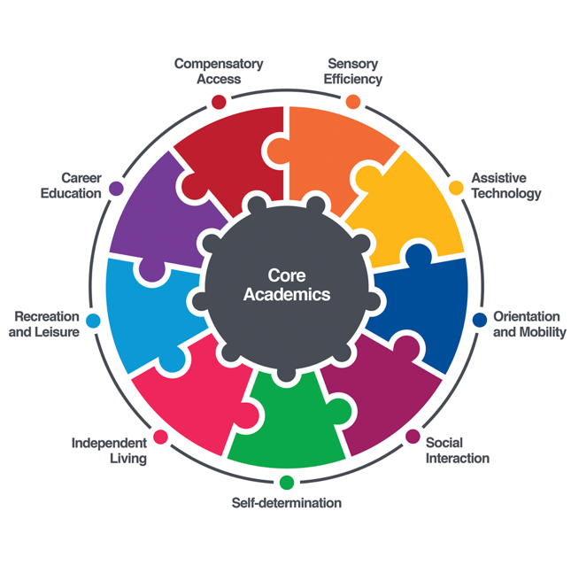

Expanded Core Curriculum
What is it and why do O&M’s need to know about it?

Slide 2
Compensatory access
Sensory Efficiency
Use of tools, adaptations, modifications that maximise a student's opportunity to access information and engage in learning materials
Can be things like braille, tactile graphics, large print, keyboarding skills
Effective use of residual vision
Making sense of the information you are receiving from your senses
Managing visual fatigue
Best use of hearing for tasks when needed

Slide 3
Assistive technology
Social skills
Braille displays, magnifiers, screen reading software
Use of smart phone, apps and smart glasses that support navigation
Also, long cane or other mobility devices
Being taught the awareness and skills to engage in a socially appropriate manner
Learning about cues for interaction when not getting visual information

Slide 4
Self determination
Independent living
Developing self confidence, making choices, effective communication, knowing and valuing yourself as a person with a vision impairment
Self advocacy, decision making, problem solving
Being able to overcome barriers
Includes skills related to personal management like personal hygiene, and other ADL’s
Independent living skills such as money handling, time management, organisation skills, food preparation, shopping etc

Slide 5
Recreation and leisure
Career education
Exposure to lots of types of careers and the opportunity to learn first hand about these
Work experience that is meaningful and relevant to the student
Support with application for tertiary study
Employment support for part time work
Ensuring modifications are made to enable participation in sport and leisure activities both for at school and for the student to take beyond school
Access to blind specific sports such as Swish, blind cricket, blind golf, AFL blind etc

Slide 6
Orientation and mobility
Traveling as independently as possible
Being able to make choices about where you go and when
Embedded across lifetime. Don’t wait until you need to skills to develop it!
Incorporates all other aspects of the ECC
https://www.svrc.vic.edu.au/expanded-core-curriculum

Slide 7
O&M’s role in teaching the ecc
O&M is the bridge that brings many parts of the ECC to life in real, practical settings.
Opportunities to practice not only travel but communication, independence, decision making, and participate in everyday life.
Essential skill to be able to access careers and sport and recreation. Can also provide purposeful travel routes to build skills and confidence
https://www.svrc.vic.edu.au/expanded-core-curriculum

