Slide 1

Supporting Children with Additional Disabilities
Katrina Lim
COMS
19 August 2025

Slide 2
Summary
What do we know about children with VI in Australia
Best practice guidelines
Educational frameworks
Other important considerations:
  Choice and control
  Communication
  High expectations

Slide 3
What do we know about children with VI?
The Australian Childhood Vision Impairment Register (ACVIR) • NextSense
Silvera, S. Martin, F., Flaherty, M., & Russell, H. (2021). Reporting on Australian childhood visual impairment: the first 10 years | Eye

Slide 4
What do we know? (Silvera et al, 2021)
904 children and families participated
The most common primary visual diagnoses: retinal dystrophy (17%), CVI (15%), Albinism (11%).
44% of children had comorbidities (US register reported 65.4%)
Children frequently had more than one type of disability (11% reported hearing loss, 28% speech disability, 30% learning disability, 31% physical disability.
47% reported health conditions other than VI – often more than one (14% epilepsy, 13% CP, 9% asthma, 7% ASD, 8% low muscle tone)
Notes:
.

Slide 5
What about CVI?
It is likely current Australian data does not reflect the high number of children with CVI.
In the USA, CVI the leading cause of childhood blindness and low vision (based on US Register 24% CVI; cited in Silvera et al., 2021)
CVI is common but alarmingly underdiagnosed. Fewer than 20% of likely CVI cases may receive a diagnosis (CVI by the numbers – Perkins School for the Blind)
Comorbidities reported in US register: 65% have cerebral palsy, 64% epilepsy, 72% developmental delay, 23% autism spectrum disorder, 20% genetic anomalies (cited in Silvera et al., 2021)
Information about CVI: CVI Now – Perkins School for the Blind

Slide 6
Where Do I Start?
Best practice guidelines for early intervention are very relevant for older children as well, especially those with multiple disabilities.
Consider routines-based assessment approaches e.g. Scale for Assessment of Family Enjoyment within Routines (SAFER; Scott & McWilliam, 2000), Scale for the Assessment of Teachers’ Impressions of Routines and Engagement (SATIRE; Clingenpeel & McWilliam, 2003)

Slide 7
Best Practice Guidelines
Reimagine Australia (previously Early Childhood Intervention Australia, ECIA) Home - Reimagine Australia
ECIA National Guidelines: Best Practice in Early Childhood Intervention (2016) ECIA National Guidelines - Best Practice in ECI by ECIA – Flipsnack.
  The NDIS has used these guidelines as the basis for their early childhood approach for children aged 0-9
National Guidelines for Best Practice (2nd Edition)
  Released in 2024

Slide 8
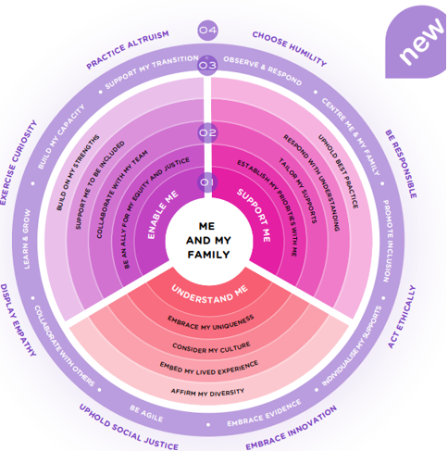
Best Practice – Some Key Points
Family and client-centred
Coaching and capacity building
Collaborative teamwork
Inclusion & Participation
Evidence based supports
Individualised and tailored supports
Strengths based approach

Slide 9
Education Frameworks
Belonging, Being and Becoming: The Early Years Learning Framework for Australia
  National approved learning framework for young children birth to 5 years old
My Time Our Place: Framework for School Aged Care in Australia
  National approved learning framework for school aged children
Both learning frameworks outline principles, practices and learning outcomes that guide educational leaders and educators in their curriculum decision-making and assist them in planning, delivering and evaluating quality programs in early childhood and school aged settings

Slide 10
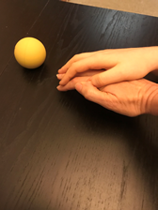
Other Important Considerations: Choice and Control
Opportunities for self-initiated, purposeful movement
Opportunities for child to explore, learn, and be part of the world around them e.g. involvement in daily routines (inclusion)
Bodily autonomy, treat hands with respect e.g. hand over hand vs hand under hand, cueing hierarchies
Restrictive practices

Slide 11
Considerations: Communication
Support child to know who you are and model strategies e.g. name, identification cues as well as verbal introductions
Supporting children to anticipate routines and what is happening next e.g. verbal, touch, object cues.
Recognise behaviour as communication
Collaboration with family and other professionals e.g. speech pathologist, behaviour support specialist to understand child’s communication, preferences and identify appropriate strategies.

Slide 12
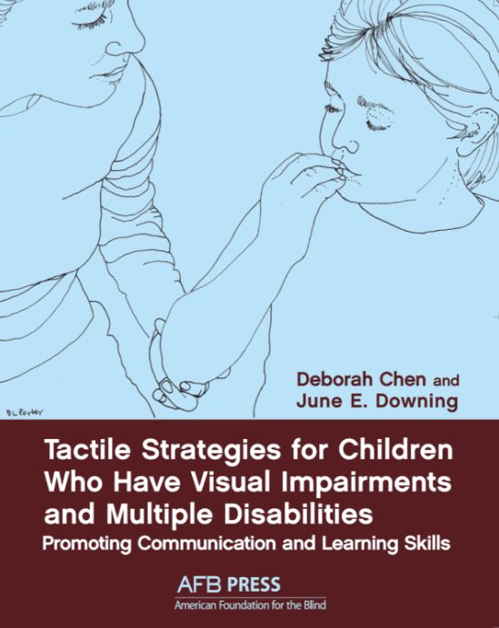
Resources
Tactile Strategies for Children Who Have Visual Impairments and Multiple Disabilities: Promoting Communication and Learning Skills | American Printing House
Active Learning Space - Active Learning Space
Hand-Under-Hand Interactions | National Center on Deafblindness
Making play inclusive - Hand under hand communication

Slide 13
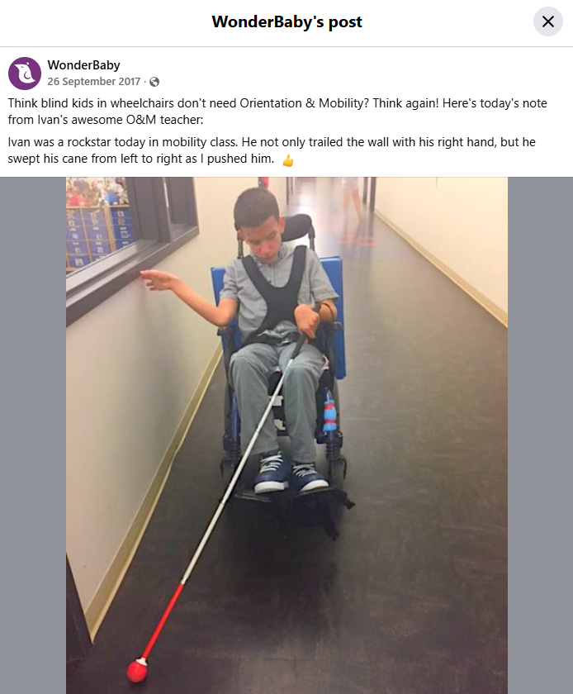
Considerations: Promoting High Expectations
Consider child’s capacity to learn and refine O&M techniques e.g. guiding
Considering opportunities for greater independence - even when travelling accompanied e.g. mini-routes, turning shower on/off, packing/unpacking lunchbox.

Slide 14

Thank you

