Slide 1

Certified Orientation and Mobility Specialists in Australasia
COMS
Community of Practice Session
23rd November 2021
Notes:
DARREN TO INTRO WELCOME

Slide 2
Welcome
  Q&A with Kathy Zeider, President & CEO of ACVREP
  Presenters today:
  Darren Moyle COMS
  Alicia San Martin COMS
  Lil Deverell COMS
  Paula Foote COMS
  Angela Reynolds COMS
Notes:
Darren to speak
We are very lucky to have Kathy Zeider, President & CEO of ACVREP here with us today all the way from Tucson Arizona. And the following presenters :
Darren Moyle COMS
Alicia San Martin COMS
Lil Deverell COMS
Paula Foote COMS
Angela Reynolds COMS
Darren to introduce Paula who will host the Q&A with Kathy.
Paula has questions to ask- First question : Why do you think its important for O&M’s to have certification?

Slide 3
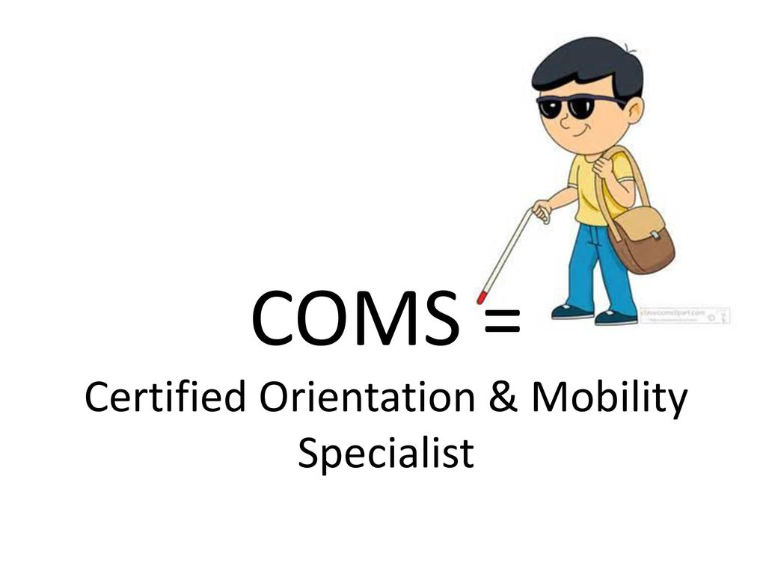
Why employ a COMS certified practitioner
Validates individual knowledge, skills, training and abilities
Stakeholders are able to identify individuals with competencies (NDIS)
COMS is objective independent third party evaluation
COMS is an evaluation of our professional competence
Notes:
PAULA
COMS is a high-quality international certification
Validates an individual’s knowledge, skills, training and abilities
Allow NDIS participants and other stakeholders to identify individuals with the high calibre of O&M skills needed to perform our specialised role
We have all been through different training course throughout the years and this additional accreditation provides us the opportunity to check on our skills and knowledge
COMS is an objective, independent, third-party evaluation and assessment of professional competence
Describe little graphic picture man walking happily with a long cane

Slide 4
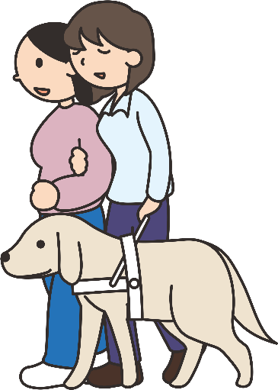
Why employ a COMS certified practitioner
Practitioners gain greater confidence in professional competence
Continuing education points has potential for increased job satisfaction
Provides public, information regarding quality of services provided
Family able to make informed decision regarding quality of service
Notes:
PAULA
Provides practitioners with greater confidence in their professional competence – on a personal note, I know that I have benefited from undertaking COMS. It really helped me identify specific areas of O&M that I needed to study up on.
Recertification requires continuing education points which can have the benefit of providing us with increased job satisfaction – I know that when I go to a conference or undertake professional development, I get enthusiastic and want try out or research the information that I have received from my PD.
COMS Certification provides the public, specifically those seeking and receiving services, greater information in relation to the quality of services available

Slide 5
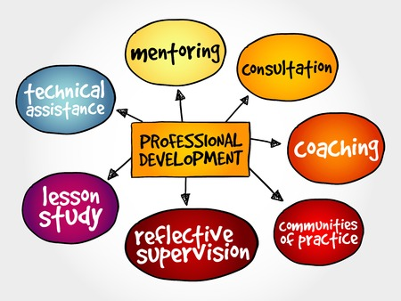
COMS Opportunities
Work as an independent service provider
Professional opportunities - Member of the ACVREP COMS Exam Review Team
Employee of UNSW – Tutor for Orientation and Mobility Methods
COMS highlighted gaps in my learning
I am responsible for my professional development
Notes:
PAULA
Self employed – This is something that I would have never imagined I could do, but with COMS certification I have the knowledge that I am providing a high quality O&M service for my clients.
I am a member of the ACVREP COMS EXAM REVIEW TEAM This have been a fantastic professional opportunity for me to liaise with O&M’s and GDMI’s from USA, UK, Ireland, and NZ and just knowing that we are working hard to make the COMS Exam equitable for all COMS candidates is great.
I have recently been employed as a Tutor for the UNSW ‘O&M Methods’ Graduate Diploma Course. Only COMS accredited O&M’s are eligible to provide tutoring for the UNSW O&M course
It was only when I studied for COMS that I realised how much I didn’t know.
By doing COMS I realised that I needed to be responsible for my own professional development. And lucky for me I was able to get a fantastic study buddy and we have continued to bounce ideas and build our resource with each other ever since.
PAULA TO HAND OVER TO ALICIA

Slide 6

Complete Eligibility Application
Qualification
Core domain checklist
Workplace experience
A strong letter of recommendation
Notes:
ALICIA
So I am going to speak about how to actually complete your eligibility application which is the first step to getting your COMS certification.
So your eligibility application has four different components that relate to your
Your Qualification
Your Core domain checklist of your qualification
Your workplace experience
Your strong letter of recommendation
So lets break down the steps for your eligibility application

Slide 7

1. Qualification
Obtain a copy of your university transcript here Aus/NZ for $13 : https://www.myequals.edu.au/.
Scan the original to upload electronically, then email certification link to ACVREP
Notes:
ALICIA
Your Qualification
If your qualification is from a university, go can simply go to the “my Equals” website to Arrange a “my Equals” transcript. My equals is The Official Platform of Australian and New Zealand Universities that provides secure access to certified official transcripts and degree documents for a flat rate of $13 aussie dollars.
You provide the my equals link to ACVREP and they can then view your transcript, knowing that its fully certified by the tertiary provider.
If you do happen to have your original university transcript, you can also still use that, I will explain how in the next slide.

Slide 8

1. Qualification
For RTO Courses and in house agency based training programs, obtain a copy of your transcript from the provider.
Have the transcript certified, scan the original to upload electronically, and post a certified copy to ACVREP
  Certification can be provided by: In Australia: JP, pharmacist, police officer, lawyer, doctor, dentist, OT, physio, chiropractor, vet, chartered accountant, bank officer, army officer, postal officer, school teacher, etc.
  In NZ, apply online https://www.govt.nz/browse/passports-citizenship-and-identity/proving-and-protecting-your-identity/use-your-nz-documents-overseas#how-you-apply
Notes:
ALICIA
For registered training organisation courses, and in house original agency based training programs that were common before university based courses, obtain a copy of your transcript from the provider.
Have the transcript certified, scan the original to upload electronically to the ACVREP website, and then post a certified copy to ACVREP. This is also what you do if you are using an original hardcopy of your university transcript.
Certification can be provided by: a range of different professionals in Australia.
In NZ, apply online by using the link here. https://www.govt.nz/browse/passports-citizenship-and-identity/proving-and-protecting-your-identity/use-your-nz-documents-overseas#how-you-apply

Slide 9

2. Core Domain Checklist
This is evidence that your course met the core domains of COMS body of knowledge.
Visit the OMAA website contact us page to request the core domain area chart from your applicable course. https://www.omaaustralasia.com/contact/
Your core domain area chart will be on OMAA letterhead and signed. It will need to match your transcript.
Notes:
ALICIA
You will also need evidence from OMAA that the O&M course you completed met the core domains of COMS (Paula will delve into the domains a bit later).
To obtain this evidence, please visit the OMAA website contact page and request the core domain area chart from your applicable course. Make sure you include the correct title of the course you completed and the year you graduated in your request.
Your core domain area chart will be on OMAA letterhead, signed and emailed straight to your inbox. The chart It will need to match your course transcript.

Slide 10
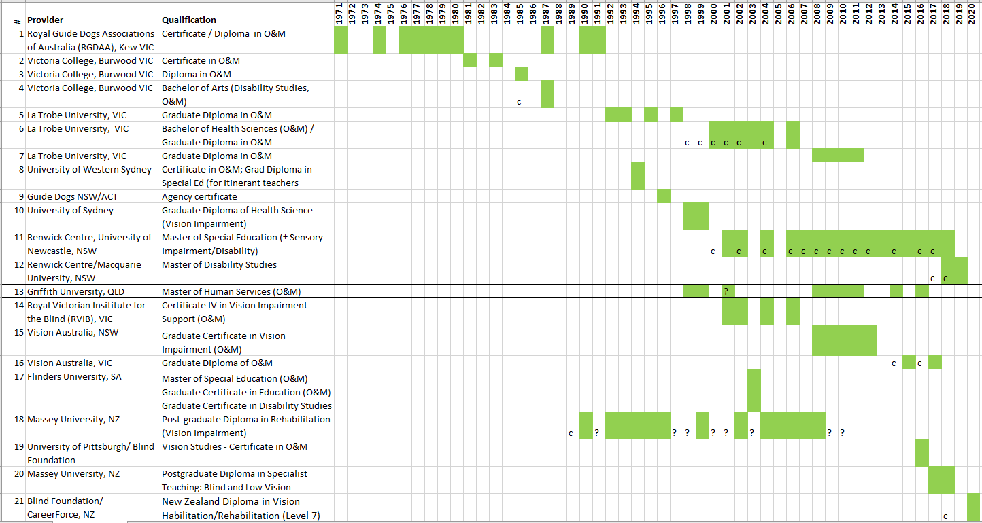
O&M Qualifications since 1971
Notes:
ALICIA
You can see here how most of the O&M courses since 1971 have been mapped out, so your course should be listed here. If your course is not listed, please include that in a request via the OMAA website contact page.

Slide 11
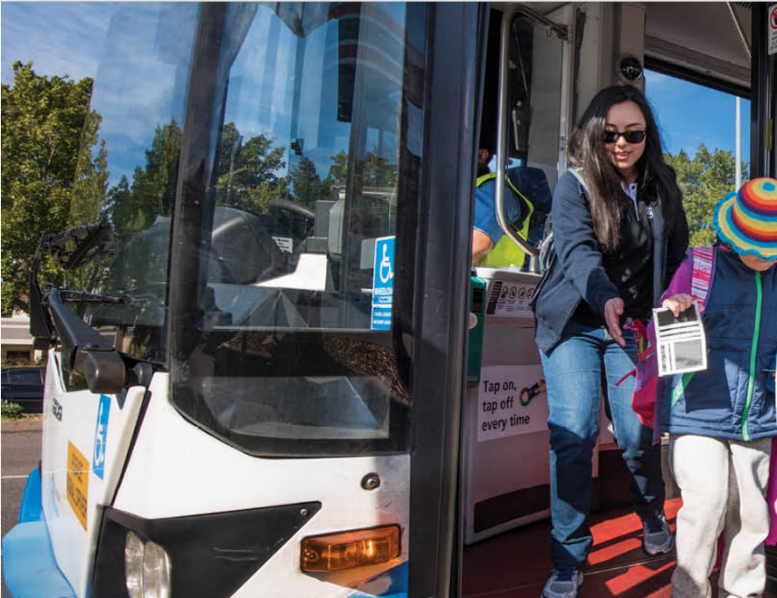
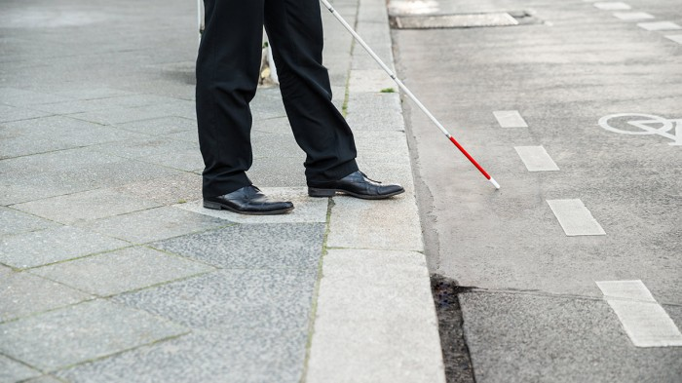
3. Workplace experience
Option 1: 350 hours of COMS supervised internship.
Option 2: Signed form from employer/s stating 3,200 hours client work, approximately 2.5 years of practice (Plus a letter of recommendation from your employer).
Option 3: Your CV showing your years of experience and O&M roles served (Plus letter of recommendation from your employer).
Notes:
Alicia to hand over to Lil
I am going to hand over to Lil now to speak about workplace experience.
LIL to SPEAK
Lil to hand back to Alicia

Slide 12
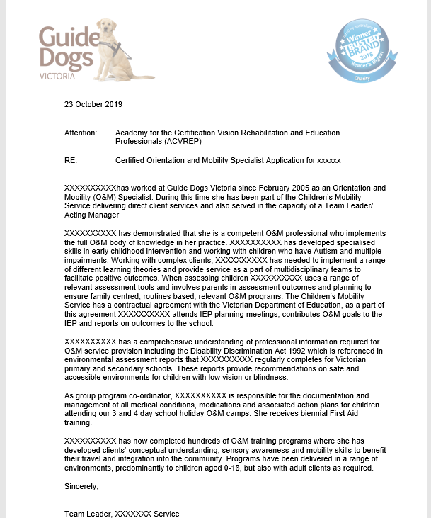
4. Letter of Recommendation
Required for option 2 and option 3.
Stating you are a competent professional, implementing the O&M body of knowledge
On agency letterhead, signed by current/most recent supervisor
Speak with a COMS at your agency or reach out to OMAA if you are not sure how to draft your letter.
Notes:
ALICIA
Lastly you will need a letter of recommendation from your agency for options 2 and 3.
The letter will state that you are a competent professional who implements the O&M body of knowledge
It needs to be on Agency letter head and be signed by your current or most recent supervisor ,
check with COMS at your agency if you need some help or for Independent O&M’s reach out on the facebook page and I am sure one of our COMS members will help you out, ,
In preparing this presentation I took at look at Darren’s letter- it was much more concise that mine, so it does not need to be as detailed as the one shown here.
Independent providers –????

Slide 13
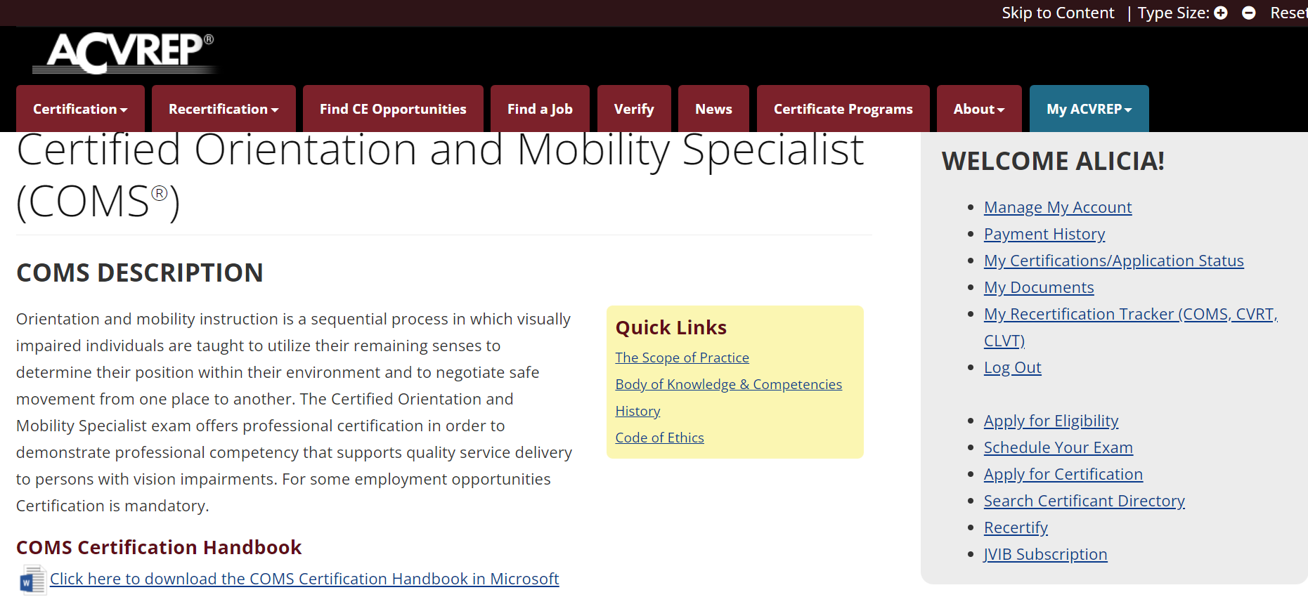
Upload to ACVREP Website
Notes:
ALICIA TO HANDOVER TO DARREN to give a brief overview of the ACVREP website
Darren- demo website and brief overview of steps to upload documents
Darren- go to the VERIFY TAB, Search outside of US, shows all O&M’s who have completed their COMS
DARREN TO HAND OVER TO PAULA

Slide 14
Testing Domains
O&M Exam Domain Area |  | Number of questions | Percentage of examination
1 | Professional Information | 5 | 4%
2 | Relevant Medical Information | 10 | 7%
3 | O&M Assessment | 16 | 11%
4 | O&M Instructional Program | 12 | 9%
5 | O&M-related Concepts | 9 | 6%
6 | Orientation Strategies and Skills | 21 | 15%
7 | Mobility Skills | 29 | 21%
8 | Use of Senses | 8 | 6%
9 | Additional Disabilities | 10 | 7%
10 | Human Development and Diversity | 6 | 4%
11 | Environmental Accessibility | 6 | 4%
12 | Psychosocial Implications | 8 | 6%
Notes:
PAULA

Slide 15
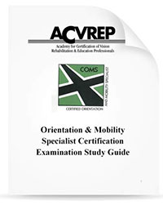
COMS Study Guide
You will need to study for this exam!
ACVREP COMS Study Guide – a must have document.
Vital information about the exam
Provides study questions with specific references to enable accurate study in each of the 12 domains.
Opportunity to identify gaps in personal O&M practice
Notes:
PAULA
Lil would like to emphasise that people know they have two goes of the exam, use the first exam as a trial run. If you don’t pass you get feedback about which domains you need to work on moew.

Slide 16
Resources – Books
‘Foundations of Orientation and Mobility’ 3rd Edition, e-pub versions available. 4th edition coming Spring 2022
‘Orientation and Mobility Techniques A Guide For the Practitioner’ Second Edition – Diane L. Fazzi and Janet M. Marlow
‘Partners in O&M’ Rona L. Pogrund and Nora Griffin-Shirley editors
Find resources in the APH Catalogue or online (Amazon, Booktopia etc) prices vary, shop around.
Consider postage costs from APH.
https://aph.nyc3.digitaloceanspaces.com/app/uploads/2021/03/19081007/APH-Press-Catalog.pdf
Notes:
PAULA

Slide 17
COMS additional resources
Quizlet app – ‘ simple learning tools that let you study anything….’ flashcards, games and learning tools all for free’.
Online learning opportunities- for example. Dona Sauerburger self study guide https://www.sauerburger.org/dona/crosscredit
APH Hive – e.g. Daniel Kish -Using Echo for mobility purposes. https://visioneers.org/textbook/
Live Binders - Chris Tabb!! A whole world or resources.
Notes:
PAULA

Slide 18
Study Groups
I’m happy to host a regular study group but …..
it’s up to you to get started.
Notes:
PAULA
PAULA TO HAND OVER TO ANGE

Slide 19
OMAA Professional Development Committee (PDC)
Members,
Ewa Borowski – Guide Dogs NSW/ACT, COMS
Kelly Prentice – Guide Dogs NSW/ACT, COMS
Nicola McDowell – NZ, COMS
Paula Foote – Independent COMS
Angela Reynolds – Guide Dogs NSW/ACT, COMS
Notes:
ANGE
Ccommunicate via website, Facebook page, newsletter.

Slide 20
OMAA Professional Development Committee (PDC)
Purpose is,
to maintain healthy communication around O&M professional development issues
to support the recertification of Australasian O&M specialists
to promote the ongoing professional development towards exemplary standards of practice of O&M specialists
Notes:
ANGE

Slide 21
Supporting O&MS with PD
Evaluate available professional development opportunities for Continuing Education points - Australasia
Sharing information about available professional development opportunities
Creating and supporting ACVREP approved continuing education events for O&M Specialists in Australasia
Notes:
ANGE
Courses
Communicate via website, Facebook page, newsletter.
Minimum of 20 points per year
Similar to teachers, Physios and OT’s.

Slide 22
2021 at a glance
Monthly meetings
Organise the OMAA O&M Symposium
Review feedback from Symposium
Currently re-viewing OMAA website
Continue to scope for PD opportunities in Australasia
Communicate back to OMAA executive
Notes:
ANGE
Sympsoium –around 7 CE points
Make website more user friendly.
Review feedback – to determine opportunities for requested PD opportunities

Slide 23
How to upload your CE points
ACVREP
Demonstration
Notes:
ANGE
Make website more user friendly.
Supportive community wrapped around us as an O&M profession to move forward and support you with this.
ANGE TO HANDOVER TO DARREN FOR WRAP UP QUESTIONS
Lil will jump in an answer any question that pop up that we don’t know !

Slide 24
ROMSA
Registered Orientation and Mobility Specialists in Australasia.
ROMSA = COMS + ordinary OMAA membership.
International certification plus local solidarity.
Notes:
LIL – to speak to this

Slide 25
Questions about COMS?
Contact OMAA via the website
https://www.omaaustralasia.com/contact/
Use the OMAA Facebook Page!
https://www.facebook.com/groups/301214854512916
Kathie Zeider ACVREP
kzeider@acvrep.org
https://www.acvrep.org/certifications/coms
Notes:
DARREN
QUESTION TIME- ASK IF THERE ARE ANY QUESTIONS. HOST QUESTION TIME.
AFTER LAST QUESTION, TELL PEOPLE WHO MAY COME ACROSS QUESTIONS TO GO TO :
The OMAA facebook page is your first point of call. Any group member can post a question and there are many COMS who can likely give you the answer.
You can also contact Kathie on the details here.
THANK EVERYONE FOR ATTENDING THIS COMMUNITY OF PRACTICE , GOODBYE.

