Slide 1
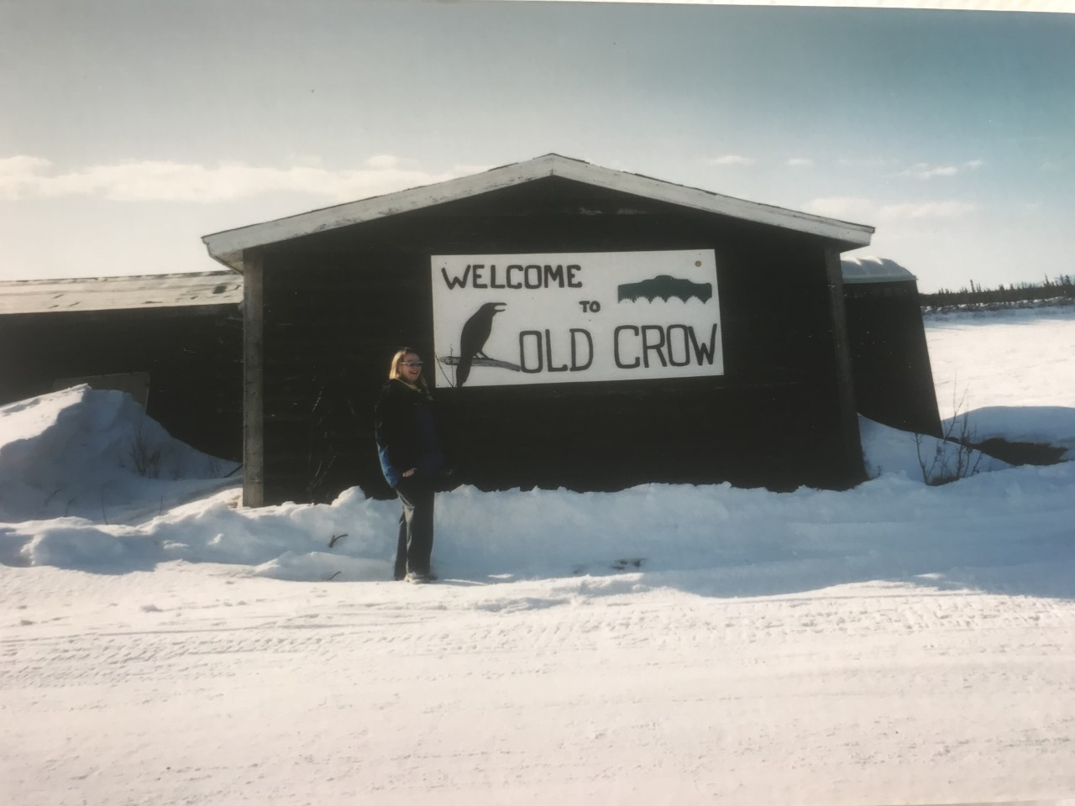
Northern British Columbia
Yukon and Canada

Slide 2
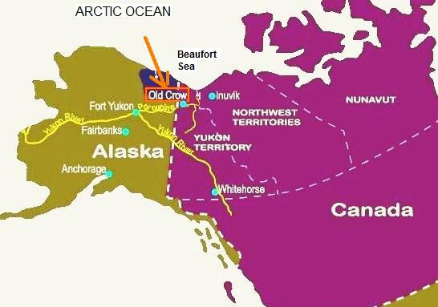

Slide 3
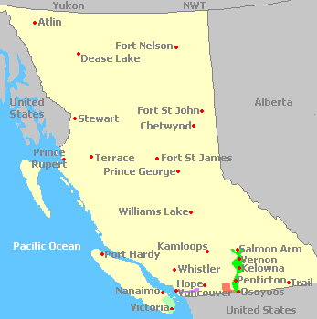

Slide 4
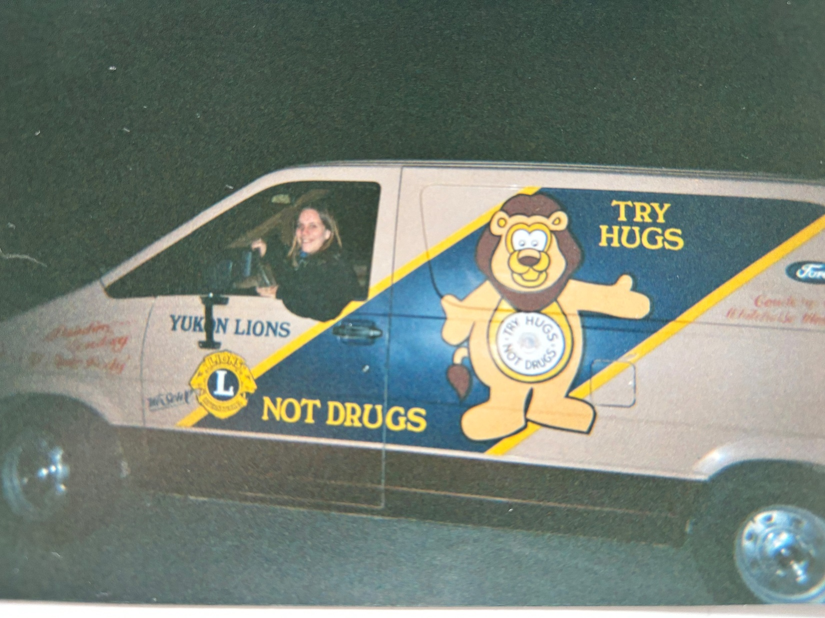

Slide 5
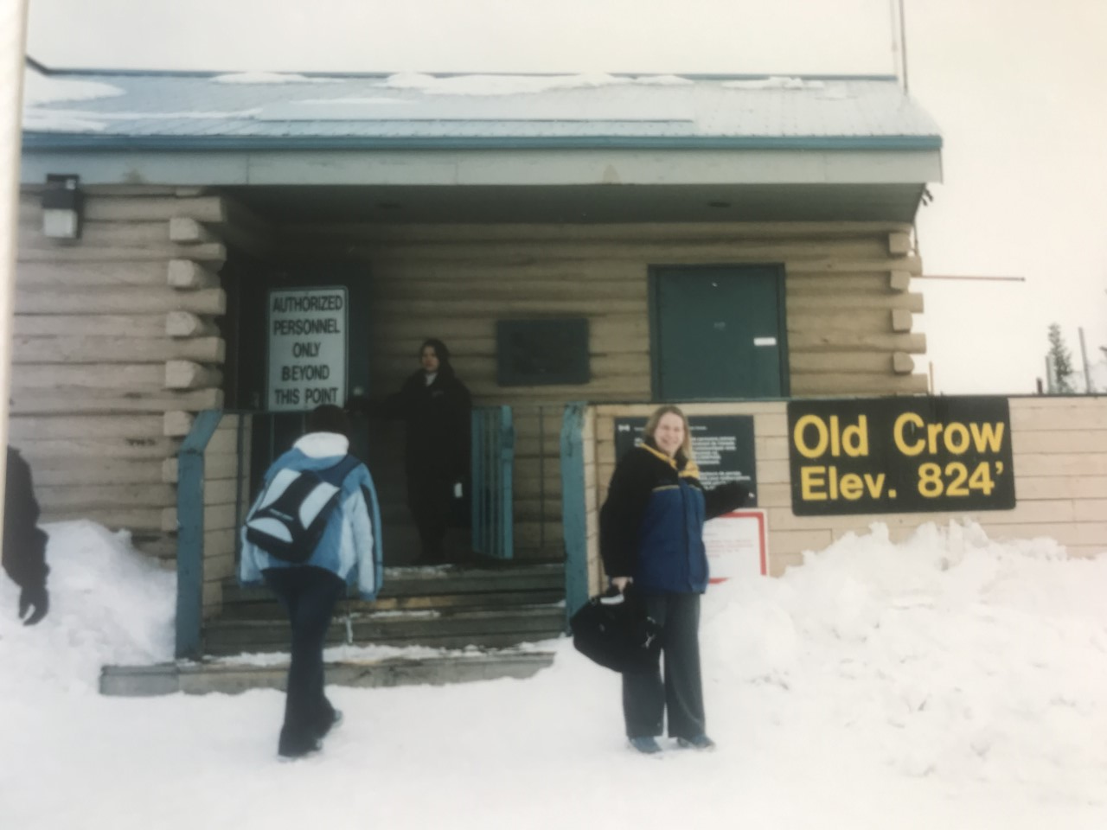

Slide 6
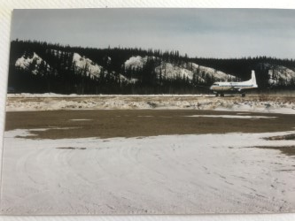

Slide 7
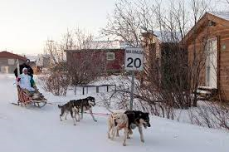
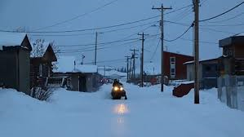

Slide 8
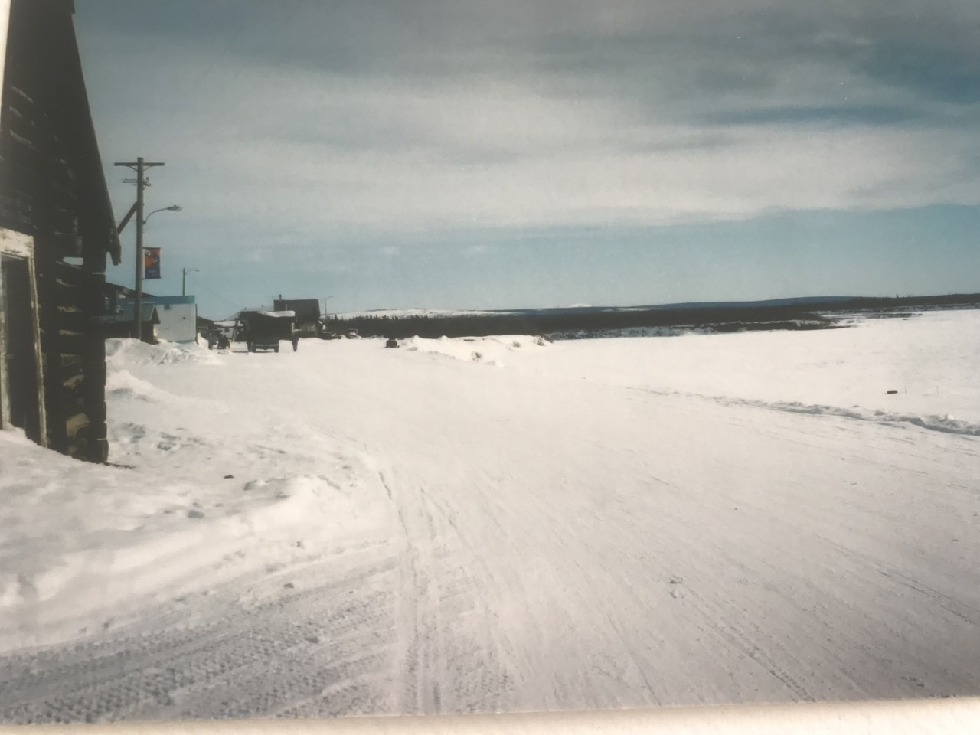
Downtown Old Crow

Slide 9
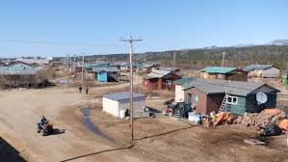
Layout in the summer

Slide 10
Snow travel
Weather gear: leather gloves, winter boots with deep grips, snowsuit, hat
Glare
Changes in conditions - by the hour
Temperatures change - I worked with students up to -25 outside
Snow paths change - Ice
Landmarks are different in winter
Sound buffers / it makes the sound crisp
Been seen

Slide 11
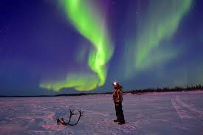
The nighttime experience

Slide 12
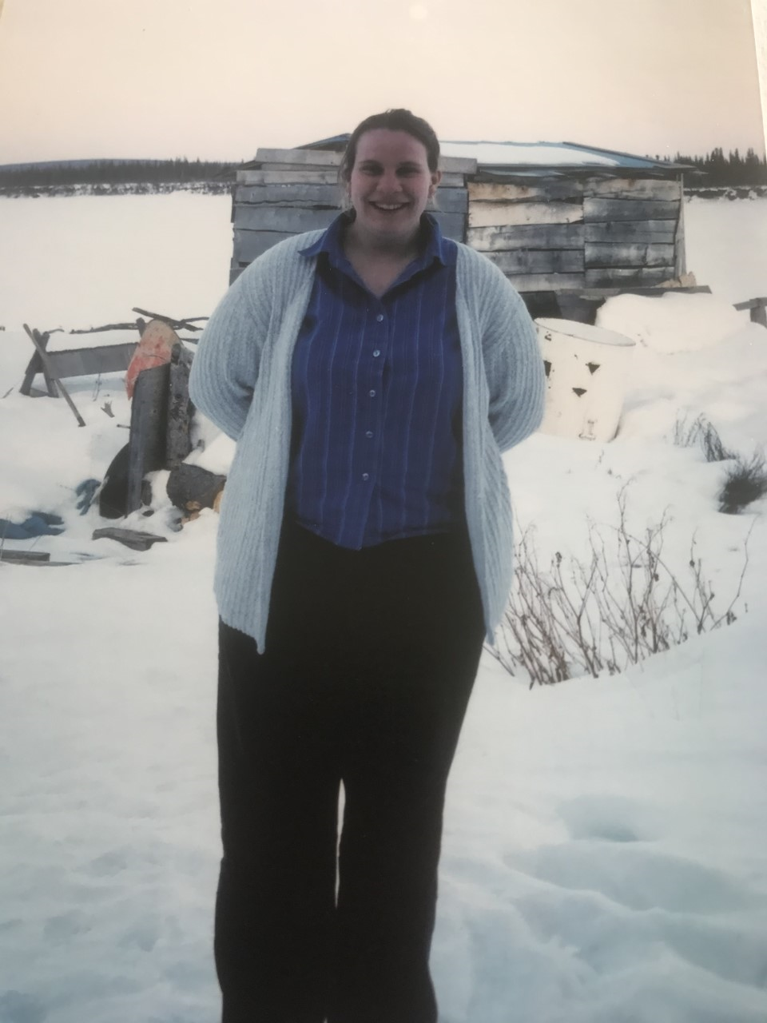
What it was really like

Slide 13
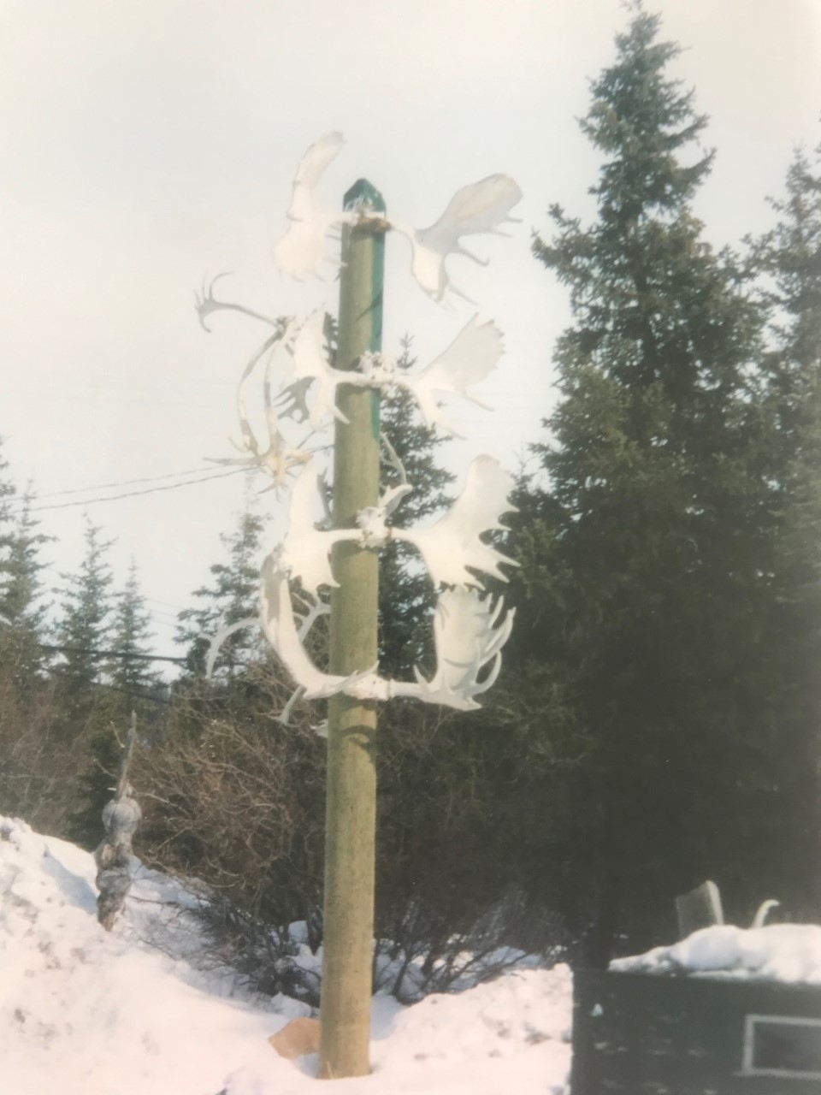
Culture: Aspect of O&M

Slide 14
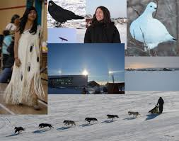
What I learnt

Slide 15

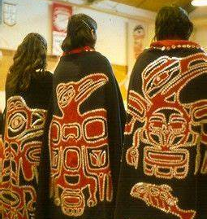
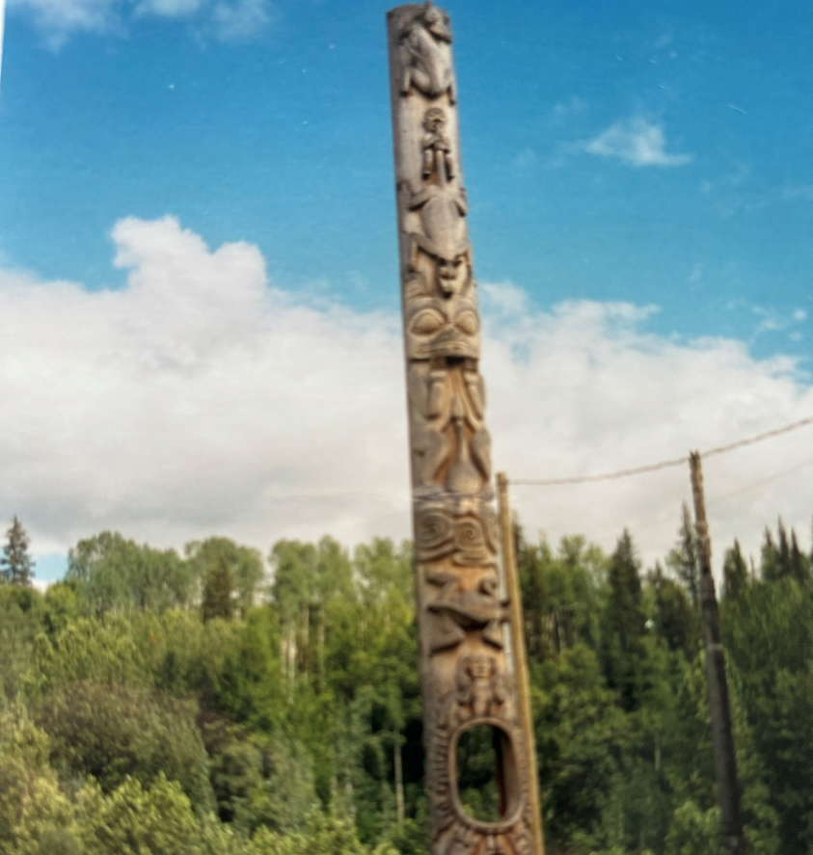

Slide 16
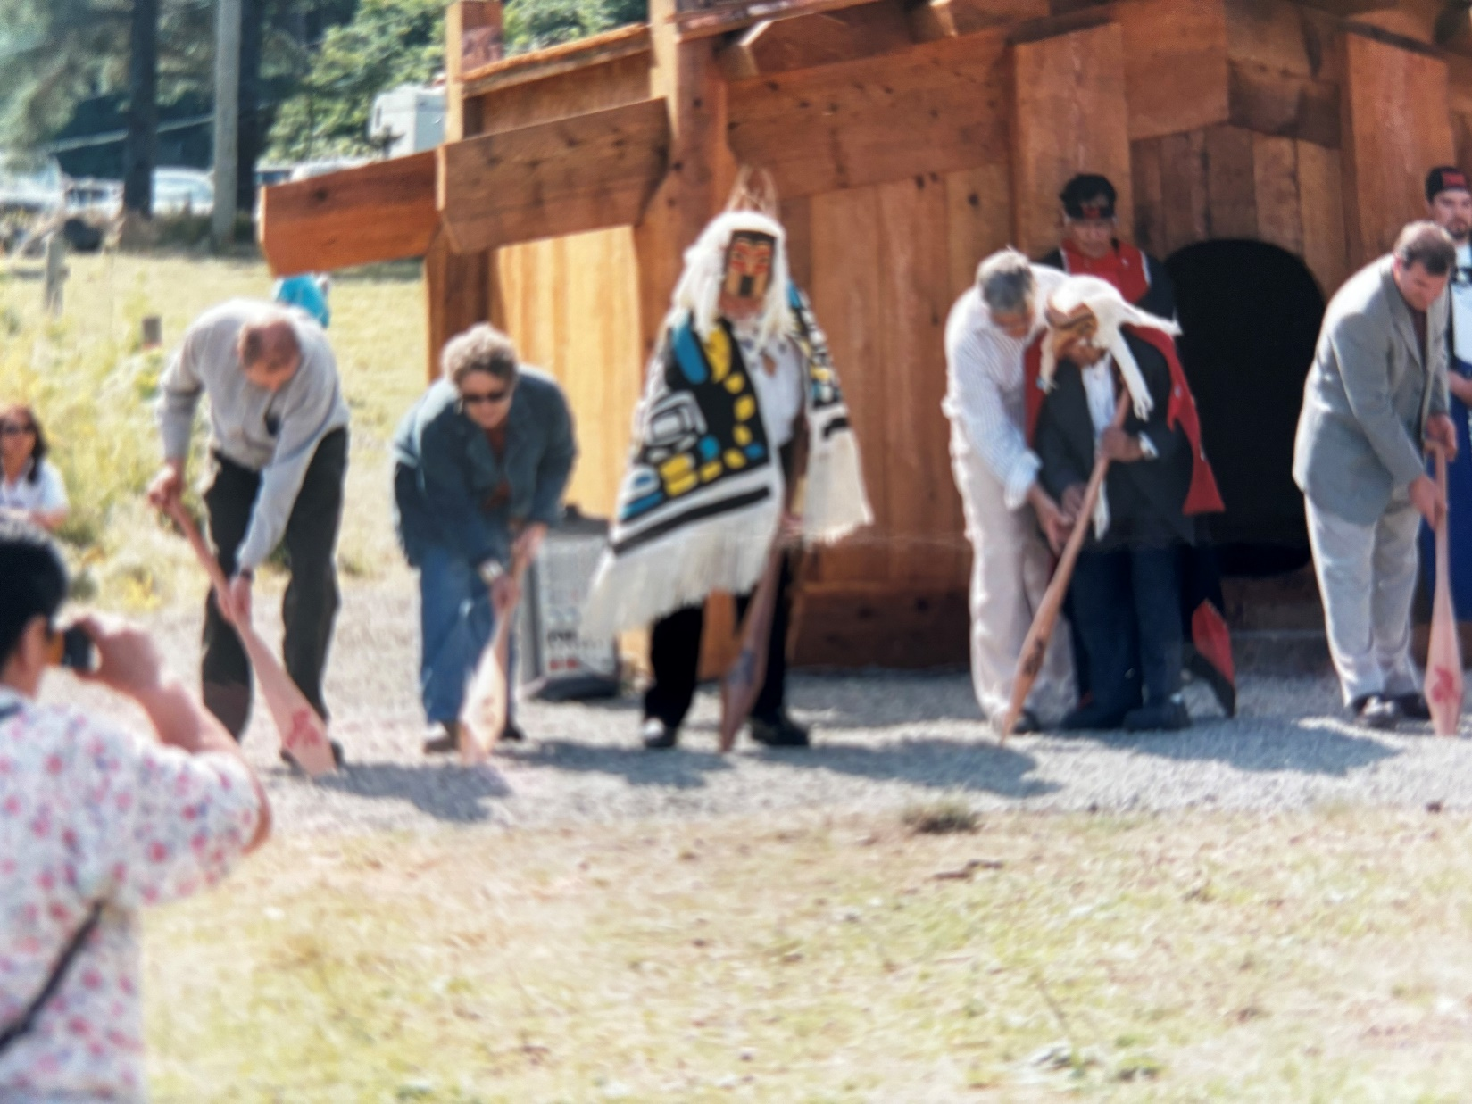

Slide 17
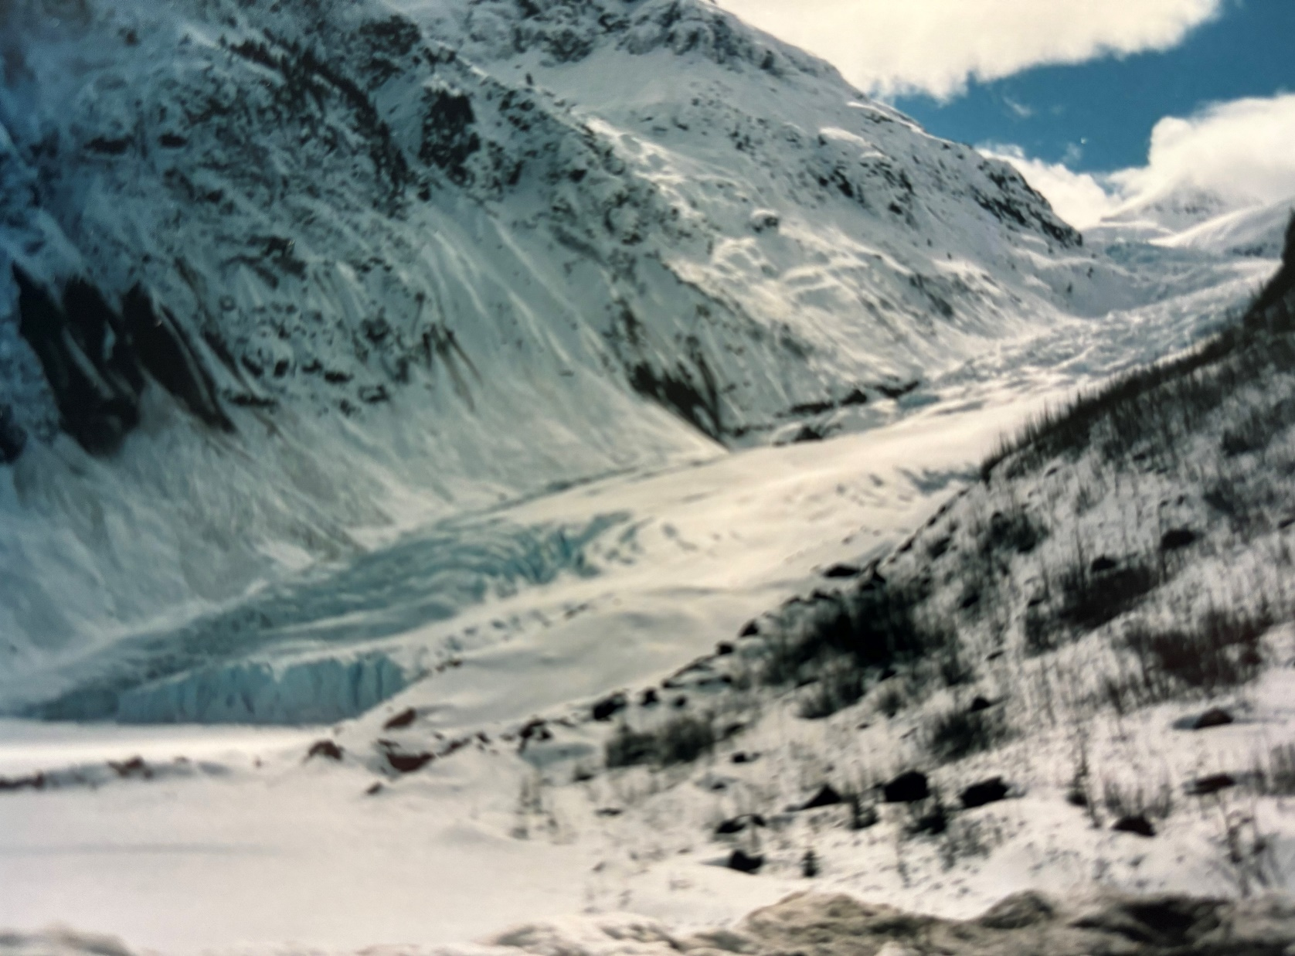

Slide 18
